Slide 1

Gasless On-Chain Password Manager with Recovery Mechanism: A Comparative Analysis Across EVM-Based Platforms
Team: 16 Members: Sania Azhmee Bhuiyan (23266033)
Syead Tanvir Islam Movin (23266009)
CSE 707: Parallel and Distributed Systems Instructor: Annajiat Alim Rasel RA: Md Humaion Kabir Mehedi

Slide 2
Outline
Background
Related work
Methodology work diagram
Detailed proposed methodology
Innovation
Results and analysis
Limitation
Future work

Slide 3
Background: In todays era of technological advancement managing numerous online identities requires robust password management is hard. Thus we use: Traditional centralized password managers are vulnerable to cyber attacks due to a single failure point On the other hand, blockchain-based alternatives struggle with gas costs and scalability.
This paper:
Introduces a novel, gasless on-chain password manager with an efficient recovery mechanism to address these challenges, particularly the gas fees issue in blockchain solutions.
It enhances existing research by: Its effectiveness is demonstrated through a comparative analysis on various EVM-compatible platforms, highlighting its performance and security.

Slide 4
Introduction: Defining the problem statement
Password managers are mostly centralized Centralized password managers pose security risks due to a single point of failure, making them vulnerable to cyberattacks and breaches.
Evidently encryption are taken into account
Despite encryption measures, these systems are susceptible to vulnerabilities like bugs and insider threats.
Further issue
Users face reliance on service providers for maintenance, raising concerns about accessibility, privacy, and dependency, highlighting the need for secure and decentralized alternatives.

Slide 5
RELATED WORKS
Open-Source Centralized Password Managers:
C. Luevanos et al.: Analyzed Passbolt, Padlock, Encryptr, focusing on features, encryption methods, and vulnerabilities. They compared open-sourced and closed-sourced managers and proposed guidelines for a robust, secure password manager.
Blockchain-Powered Password Managers:
N Jain: Proposed a blockchain-based password manager using AES-256-CBC encryption and proof of work for transactions.
D. Tse: Discussed a password-keeping system using blockchain with AES-128 symmetric and asymmetric encryption, emphasizing security and trustworthiness.
Decentralized Identity Management and Access Control:
C. -H. Liao et al.: Introduced BIMAC, a banking ecosystem-specific decentralized framework using smart contracts and stateless authentication.
A. Catalfamo et al.: Proposed the MBB-OTP protocol, combining microservices architecture and blockchain for generating and delivering OTPs.
Blockchain for Password Monitoring and Validation:
A. Debbie et al.: Patented a system for monitoring and validating passwords across domains using blockchain to store and compare password hash values.
Blockchain in Identity and Access Management:
I. A. Mohammed: Focused on Ethereum for identity and access management, utilizing hashing, proof-of-work, and smart contracts.

Slide 6
METHODOLOGY
Architecture Design Integrating encryption mechanisms, cryptographic key storage protocols, and recovery mechanisms.
Incorporated Blockchain Technology smart contracts and blockchain technology for gasless transactions and recovery procedures.
Prototype development
1.Backend: Node.js.
2.Smart Contract Development: Hardhat and Solidity.
3.Testing: JavaScript libraries like Chai and Mocha.
Research and Requirement Analysis
This included a focus on different cryptographic algorithms, key management approaches, account recovery methods, grassless transaction mechanisms, nuances of implementation on various EVM-based platforms, and design considerations for smart contracts and web2 components.
Initial Setup
Setting up a Node.js project.
Creating a smart contract development environment using Hardhat
Smart Contract Development Developing and compiling the smart contract using Solidity. Deploying the contract using Hardhat.

Slide 7
METHODOLOGY (continued…)
Testing and Deployment
Writing test scripts in JavaScript to verify contract behavior.
Custom deployment scripts in JavaScript.
Deploying contracts on 12 different Ethereum Virtual Machine (EVM) compatible blockchains
Cryptographic Implementations
Implementing two different cryptographic algorithms in the backend.
Writing scripts to compare their performance.
Simulating key exchange, encryption, and decryption flows in JavaScript.
Exploring two encryption algorithms: AES 256 (symmetric) and Falcon (asymmetric)
Performance Testing
Testing the performance and gas cost of five smart contract functions:
registerFunction, registerPlatform, storePassword, getPassword, freezeAccount.
Utilizing the Ethers library for off-chain signature simulations

Slide 8
PROPOSED METHODOLOGY System Components Overview:
Client
User's device acting as the gateway to the gasless password manager system.
Next JS, HTML, and CSS stack used for the frontend application.
Manages symmetric and asymmetric key pairs for password encryption.
Handles asymmetric key pairs for ring signatures and blockchain address key pairs.
Web2 Backend Server Manages backend operations, including key pair storage for admin blockchain address.
Provides RESTful APIs for secure communication between frontend and blockchain.
Offers APIs for smart contract interactions, initiating actions on behalf of users.
Blockchain Utilizes blockchain technology for decentralized and secure password management.
Ensures data integrity, security, and transparency through a distributed network.
Protects encrypted password data using a consensus mechanism, eliminating single points of failure.
Smart Contract
Controls interactions with the blockchain.
Created using Solidity, performs predefined functions like storing encrypted passwords.
Enables gasless transactions and establishes guidelines for user authentication and access control.
Decentralized Oracle
Connects blockchain with off-chain world, generating secure and transparent random numbers.
Utilizes decentralized oracle networks like Chainlink for reliable data collection.
Ensures randomness and reliability through multiple independent data sources and consensus mechanisms.

Slide 9
Core Functionalities
Store Encrypted Password
Register User
Client application installed, sets up key managers, and creates key pairs.
Registers user on the backend through REST API call with blockchain address.
Register Platform
Client calls REST API with user blockchain address and platform name.
Platform is registered on the smart contract through API call.
Gasless Password Management Implementation
Secure transmission of user's public key.
Random number generation from decentralized Oracle.
Encryption of random number using Elliptic Curve Cryptography (ECC).
Transmission and decryption by the user.
Off-chain signature creation ('v', 'r', and 's').
Secure password saving with off-chain signature.
Smart contract validation and password saving.
Freeze Account
user's private key was compromised and user wants to change the key

Slide 10
INNOVATION/NOVELTY OF THE WORK
Gasless Password Management (EIP 712)
Quantum Resistance Cryptography
Managing Keys on User's Device
Web3 and Web2 Component Setup:
Recovery Mechanism
Implements a secondary account on a backup device for account freezing.
Explores the use of biometric IDs for recovery.
Comparison on Different EVM Platforms
Platforms include Ethereum, Polygon, Celo, Avalanche, Hedera Hashgraph, Binance Smart Chain, Arbitrum, Optimism, Fantom, Cronos, Tron, and Conflux.

Slide 11
RESULTS and ANALYSIS
 | AES 256 | FALCON
Key Length | Uses a 256-bit key, offering high security | Key size varies by security level; 512 bits for NIST level 1 and 1024 bits for level 5.
Resistance to Known Attacks | Extensively analyzed; no known practical attacks. | Secure against known attacks; designed as a post-quantum cryptography (PQC) algorithm to resist quantum computer attacks.
Performance | Efficient and suitable for various applications. | Slower than AES 256 but efficient for high-security needs like digital signatures.
Quantum Resistance | Quantum-resistant | Quantum-resistant, based on lattice-based cryptography
Overall Security | Very secure but not quantum-resistant | Secure and quantum-resistant, ideal for future-proof digital signatures
Encryption Time | AES-256 is slightly slower (mean: 59.697ms) than FALCON (mean: 50.994ms)
Decryption Time | AES-256 is faster (mean: 0.0535ms) compared to FALCON (mean: 0.228ms).

Slide 12
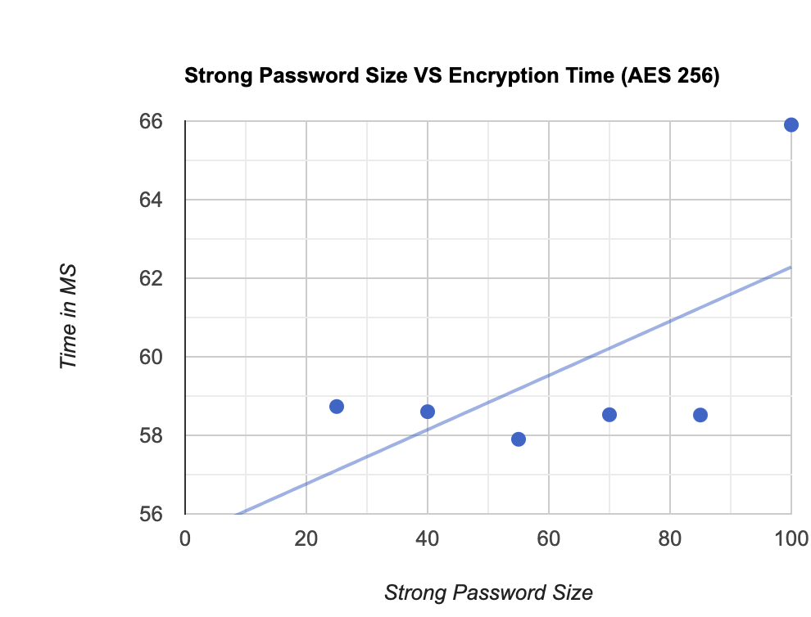
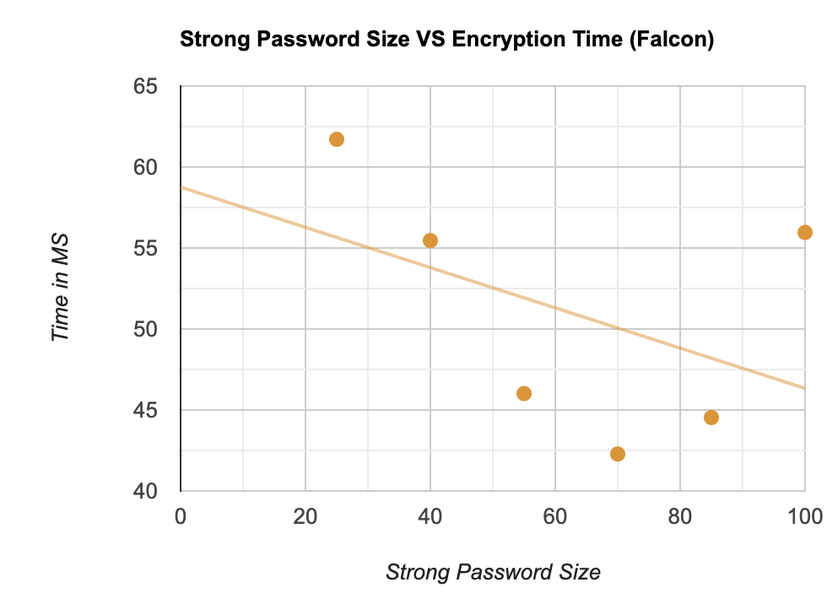
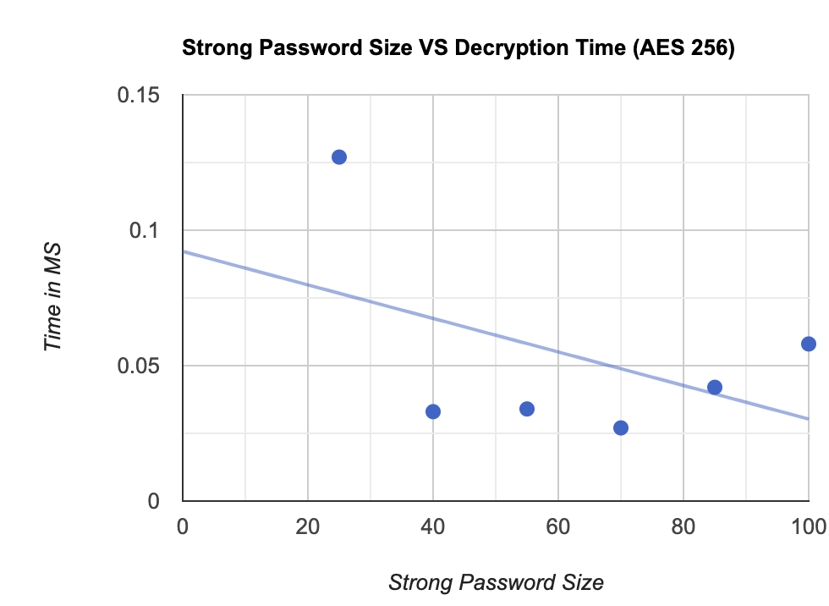
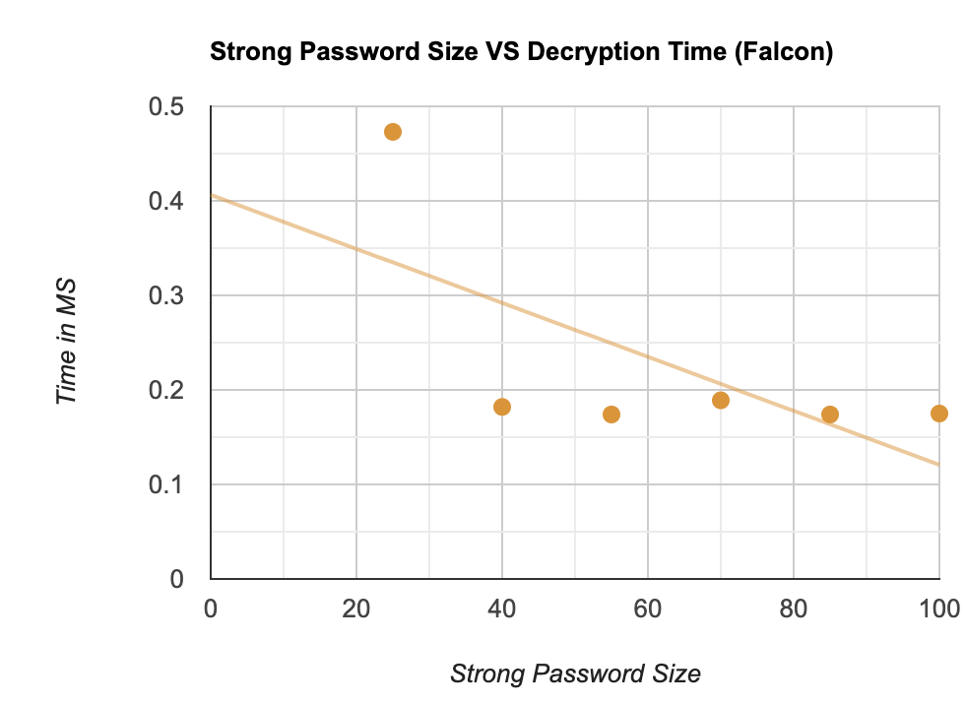

Slide 13
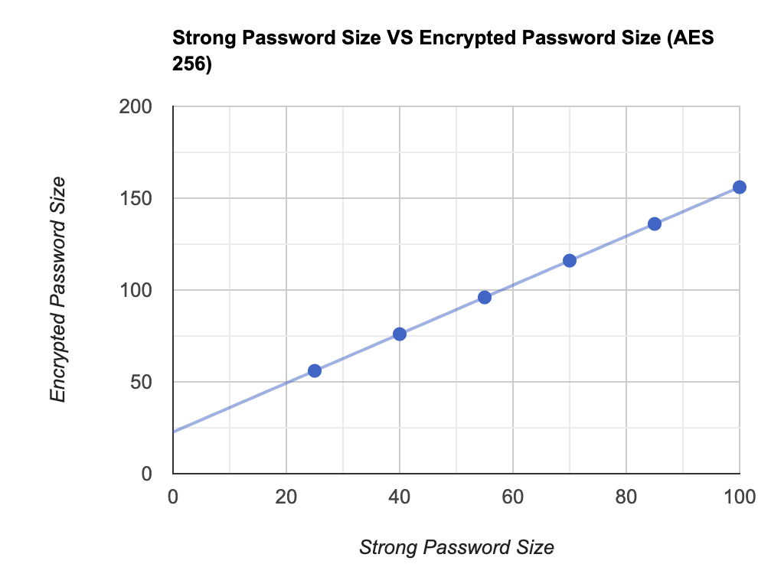
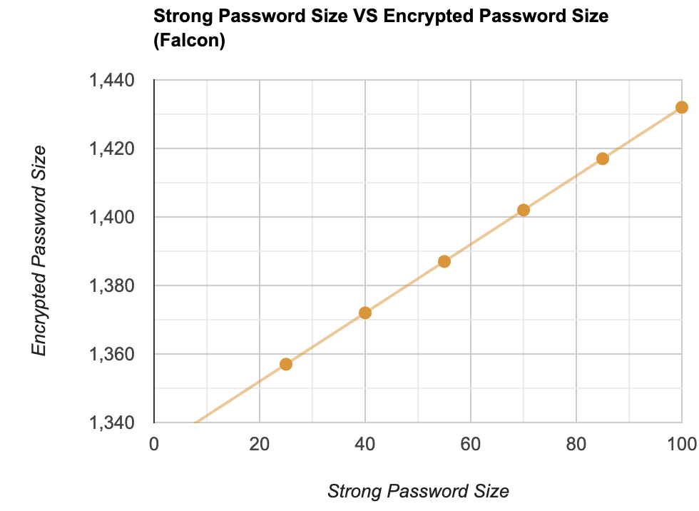
Overall Security (conclusion)
AES 256: AES 256 is a very secure algorithm that is well-suited for a variety of applications.
FALCON: FALCON is a secure algorithm that is well-suited for applications that require digital signatures. FALCON is also quantum-resistant, but little bit slower than AES 256, it is more useful in cases where security is more concern.

Slide 14
Limitation
Scalability and Performance Issues
Dependence on Blockchain Reliability
Complexity of Implementation
Quantum Computing Threats
User Adoption and Trust Issues

Slide 15
Future work
Optimize for high transaction volumes to improve scalability and performance.
Implement advanced cryptography against quantum computing threats.
Expand research to include non-EVM blockchain platforms for broader applicability.
Further simplify the user interface for wider accessibility.
Continuously update the system to counter new cybersecurity threats.
Develop strategies for enhancing user trust and adoption, including user testing and feedback integration.

Slide 16
THANK YOU

